Slide 1



Innovation Generation
як змінити освіту і отримувати системну вигоду
Vasyl Matyashovskyy
Academic Board at LvBS
vasyl@lvbs.com.ua

Slide 2

Topic. Diploma. Coursework. western approach
Real
Problem
/Idea
Mentor:: Business
Mentor:: Univer.1
Student
Mentor:
Univ.2
Paper
+
Solution,
Pilot
~Framework~

Slide 3


Topic. Diploma. Coursework. western approach
Outcome:
  Student: Practical experience + New Job
  Company: cost effective innovations + New Staff
  Org and business development
  University: innovation paper, research, $
  Industry: alignment between business and university; commercial innovations

Slide 4

Topic. Diploma. Coursework.
Post USSR approach
Problem
/ Idea
Mentor:: Business
mmm
0 0
Diploma supervisor
Univ.
Student
Mentor:
Univ.2
Theoretical solution
~Framework~

Slide 5

Topic. Diploma. Coursework.
Post USSR approach
Outcomes:
  NO practical experience. NO new job. (for Student)
  NO innovation/solution (for Company)
  LOW value research (for University)
  NO alignment with real world
  Wasted time
  Retired knowledge
  No idea about real business
  /industry

Slide 6


Post USSR approach
What is behind?

Slide 7

western approach
What is behind?
Delft TU.. CMU.. MIT.. Amsterdam.. Stanford..
Business
University
Companies problems/ideas
awareness

Slide 8

Commercialization Cases
IT Company going to start new IT product…
IT Company is looking for client/partner… or connections to a certain company…
Company is looking for a solution…
City hall / Водоканал / Kinder garden have a problem..
e-Government project researches…
You develop own product… Business transformation…

Slide 9

Pilots we did at MSTM(LvBS)
IT company order research for new IT product
A company order IT Strategy.
Creation of new IT Product for Wind Stations (with Delft TU)
e-Government: research and mngmnt solutions for 7 state processes
2 products diplomas consider by biggest retailer for integration.
Everywhere – the university, his resources and network were key component!

Slide 10

Why should you do this?
MAKE PROFFIT!!!!!!!! SAVE!!!
Attract best young minds!
Align University with Business
Create innovations for cheap
Risks:
Fail cost nothing for you, but is the valuable experience for your team, student and university
Success brings profit
Development of entrepreneurship

Slide 11

Key to success
Dedicated experienced BA on side of University
Аналіз та нарізка завдання
Залучення експертизи
Project Management and Engagement
Networking
Continuous dialogue with University
Give us your problems/challenges!
Support Pioneers of changes!

Slide 12

Think.. Change expectations.. Demand!

Slide 13

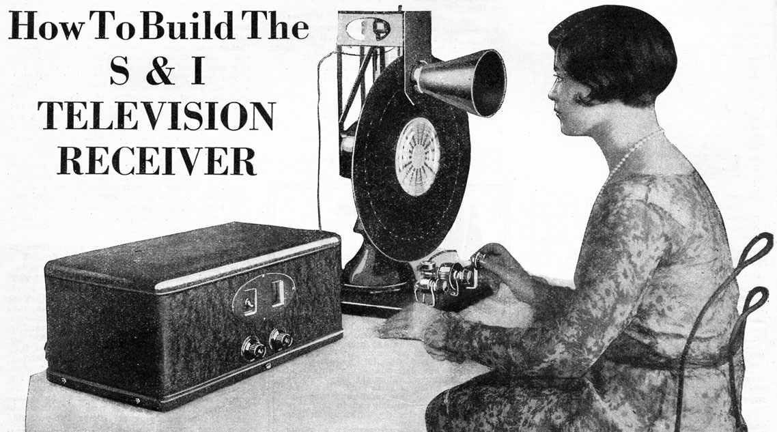
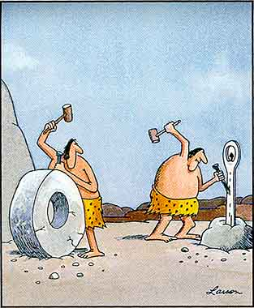

Slide 14
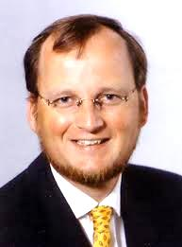
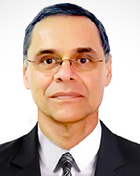
Thanks to LvBS (MSTM), UCU (CS) and to special people
Bernhard Katzy (R.I.P)
Roman Kyzyk (R.I.P)
        MDM KYZYK MEMORIAL TRUST
        c/o Theodore Bajo Trustee at 336 Clinton St Brooklyn New York, 11231 or through PayPal to mdmkmemorialtrust@gmail.com

Slide 15
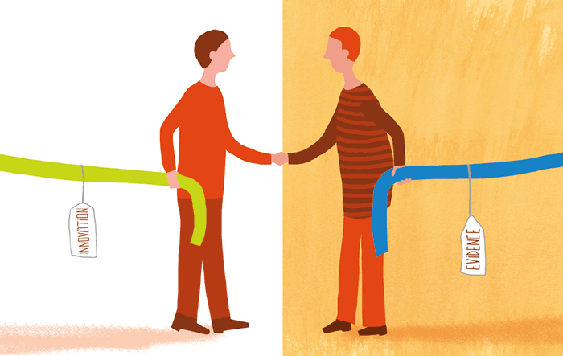
Lest connect!
vasyl@lvbs.com.ua

